Slide 1

The Battle of Neighborhoods- Milan Neighborhoods Price Houses
Gabriele cecere

Slide 2
Creative Capital of fashion and luxury, Milan is a cutting-edge city, very active in economic and cultural profile, a reality to be discovered to find its hidden treasures of poetic views, Art Nouveau buildings and small architectural gems ranging from Gothic to Romanesque style, scattered throughout its beautiful and ancient historic center, a reason that drives millions of visitors from all over the world every day to visit the city of charm and glamor. Milan is also listed within the top 10 cities for investments in Western Europe and mentioned as one of the preferred destinations for investing in the real estate sector.
Introduction

Slide 3
The aim of the project is to investigate about what are some of the variables that contribute to drive up the house's prices in some neighborhoods respect other neighborhoods. In particular the study try to analize if there is some relationship between the presence of specific venues in a neighborhood and the price's houses in that neighborhood.
Business Problem

Slide 4
To perform all the analysis and give an answer to our problem, we need to rely on some data. First of all, we need to obtain the house prices' for each area of Milan. For this aim, we need to web scrape data from immobiliare.it, an Italian platform for publishing and searching for real estate ads. Next, to obtain the geo location of each neighborhood we use ArcGIS API. Part of the Esri Geospatial Cloud, ArcGIS enables to connect people, locations, and data using interactive maps. Finally, we use Foursquare API to obtain data about different venues in each neighborhood. Foursquare is the most trusted, independent location data platform for understanding how people move through the real world.
Data acquisition

Slide 5
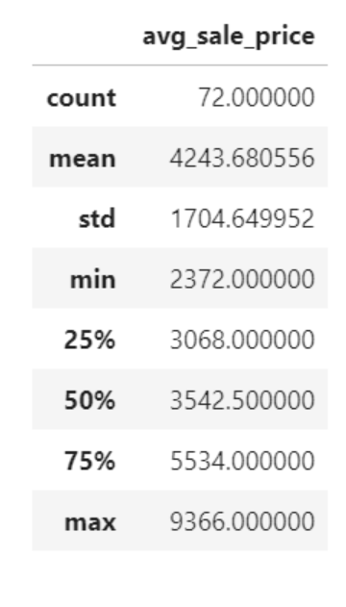
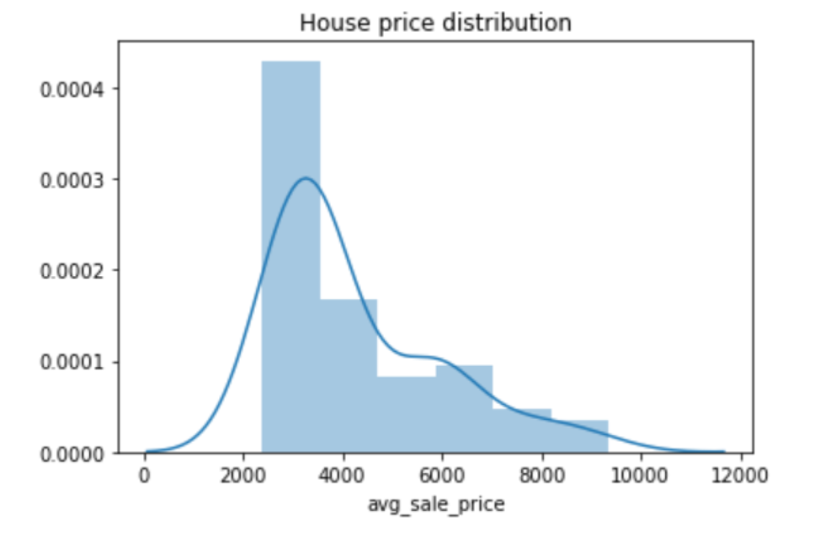
House prices distribution

Slide 6
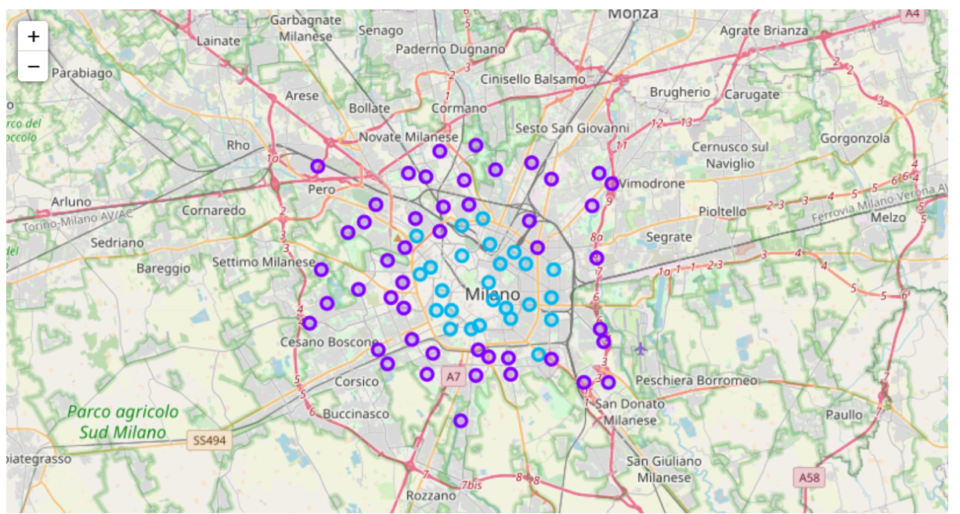
Price categories milan neighborhoods

Slide 7
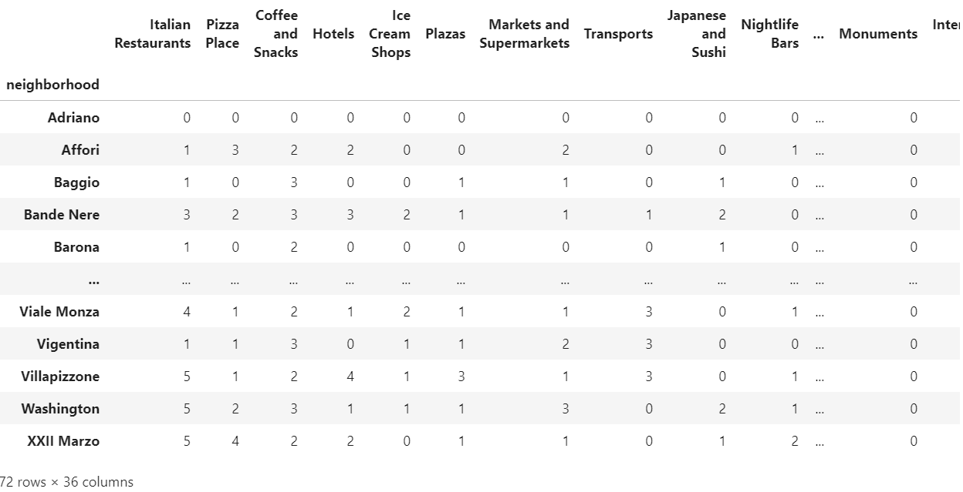
Final dataframe used to model
72 neighborhoods x 36 venues

Slide 8
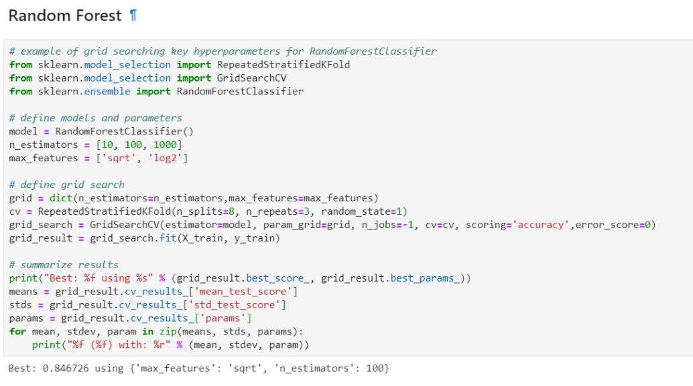
Selection machine learning model
Random forest

Slide 9
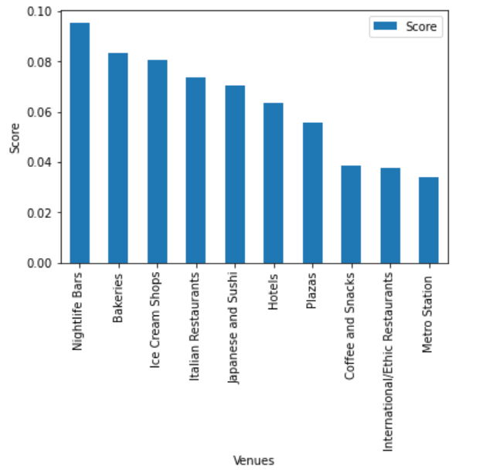
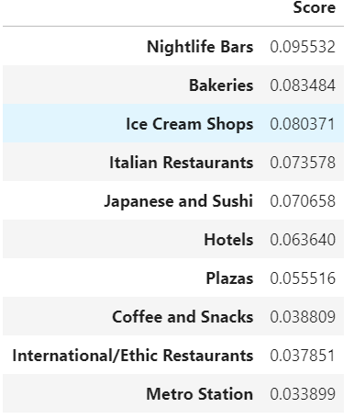
Features importance
Random forest

Slide 10
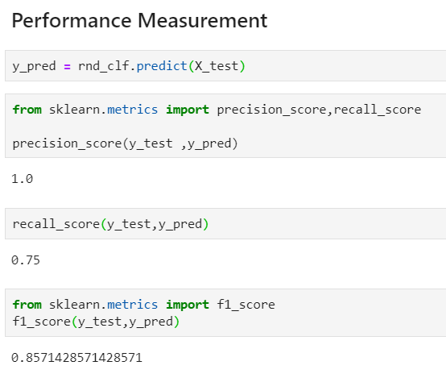
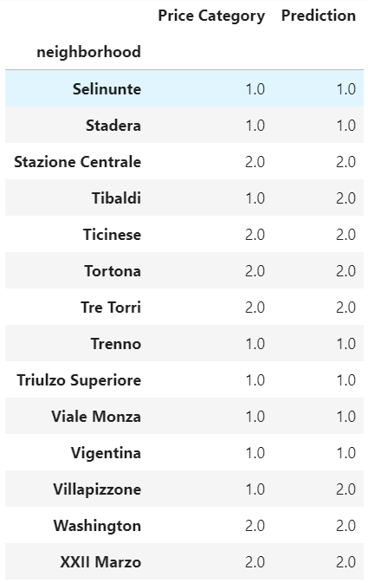
Performance measurement
Random forest

Slide 11
The model had the aim to investigate the existence of some type of relationship between the house prices in different neighborhood of Milan and the venues that there are in the same neighborhood. The model showed that the 10 most important venues to classify a neighborhood with a presence of low or medium/high price houses are: Nightlife Bars, Bakeries, Ice Cream Shops, Italian Restaurants, Japanese and sushi, Hotels, Plazas, Coffee and Snacks, International Restaurants and Metro station. This seems reasonable because the venues are related to cool neighborhoods of Milan where is concentrated the nightlife, tourism zones and neighborhoods with the presence of a Metro station that represent a key element to move easy from one part to other parts of the city. From the performance metrics we have demonstrated that the model works pretty good in the prediction of the category price of the neighborhood. We conclude that if we want estimate the price of an house, in addiction to the classic parameters like the number of rooms, square feet of the apartment and others, we can include also the presence of a venues in the neighborhood.
conclusion

